Slide 1
Program Support
EU-Japan Fest
Support Criteria
As of: 1 Sep. 2022

Slide 2

1. Artist Eligible for support
We support:
-Artist based in Japan (Any nationality)
-Japanese artist abroad
in the programs in European Capital of Culture (ECoC)
Artist based in JP
(Any Nationality)
Japanese artist abroad

Slide 3
2. Priority Order to support
We support programs as following priority:
1st Priority | ECoC of the Year
-Partial support of program cost
-Mobility Support “Passport Program”
2nd Priority | Future ECoC
-Assist in networking in Japan and other cities
-Research Travel Support (ECoC ⇔ Japan)
-Small financial support for pre-programs for ECoC
3rd Priority | Past ECoC
-Small financial support for legacy programs
-Assist in expanding network in Japan, past and future ECoCs
-Research Travel Support (ECoC ⇔ Japan)
-Mobility Support “Passport Program”

Slide 4



3. What we support
Organizers and artist should work together from preparation to legacy phase.
We do not get involved in making the program contents and curation.
We respect ECoCs’ initiative and decision.
Preparation Phase Before ECoC | ECoC of the Year | Legacy Phase After ECoC
Research Travel -Networking -Get direct contact Presentation | Official program Non labeled program Passport Program | Continued program Developed program Derived program Passport Program Research Travel

Slide 5
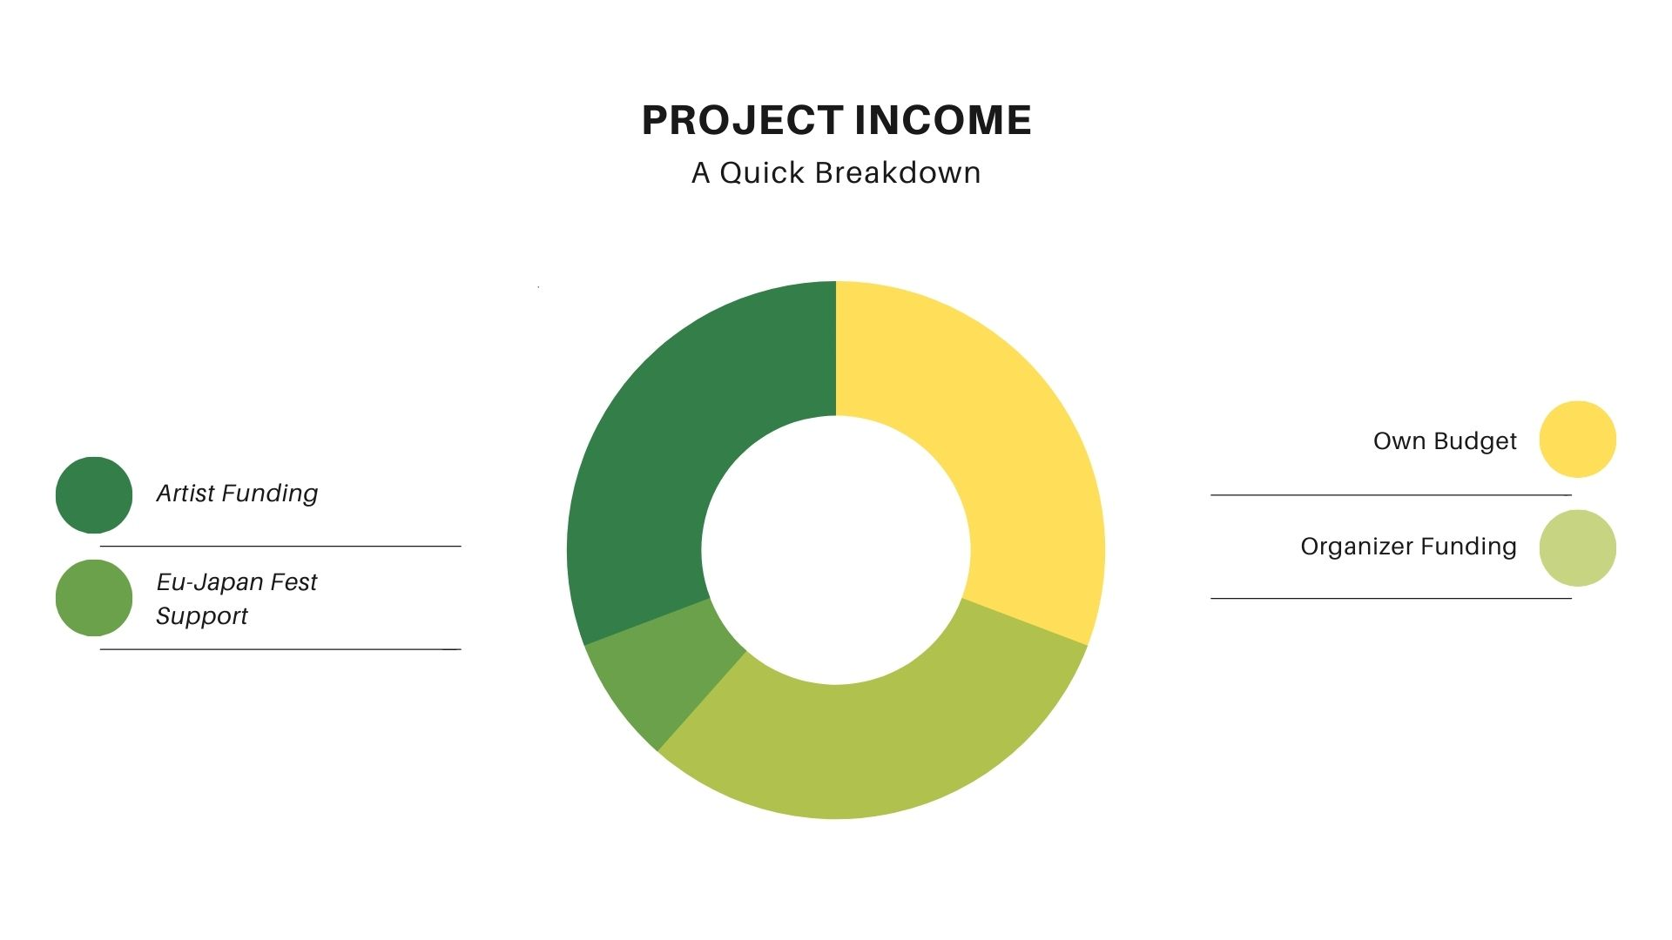
4. Funding
To encourage sustainable project and long lasting relationship, we require organizers and artists to have multiple self fund-raising effort for the application of our support. Organizers and artists that we have supported made a lot of effort to fund-raising, using public and private subsidies or crowd funding campaigns. Please see the Annex 1 for some example of public grant in Japan in the past program.
This is the reason that we can support more and more programs in ECoCs in recent years and we encourage each projects to develop in the future.
Collaboration Funding is very important!
Artist Funding:
ECoC & Local organizer
-Governmental subsidy
-Private foundation subsidy
-Crowd funding etc.
-Governmental subsidy
-Regional subsidy
-Local subsidy
-Crowd funding etc.

Slide 6
Information
You can find the following information on following pages
Possible Application to Grants
from European Side
Possible Application to Public Grants
in Japan
Possible Application to Private Grants
in Japan
Other Information Sources for Grants,
Funding Opportunities and Crowd-funding

Slide 7
Possible Application to Grants from European Side
*Check the websites for the latest information
Japan Foundation
Program Guidelines (General): https://www.jpf.go.jp/e/program/
Grant Programs within “Arts and Cultural Exchange [Culture]”:
https://www.jpf.go.jp/e/program/culture.html
  Performing Arts Japan (PAJ) Program
  Exhibitions Abroad Support Program
  Support Program for Translation and Publication on Japan
The Japan World Exposition 1970 Commemorative Fund
Information on Invitation for Application:
https://www.osaka21.or.jp/jecfund/english/information/
*Eligibility: Projects contributing to international understanding
  Projects contributing to international cultural exchange and enhancement of international goodwill
  International projects in the fields of education and academic study

Slide 8
The Nippon Foundation
Regarding detailed information about grant programs, please directly contact
the foundation via e-mails.
Contact address is available here:
https://www.nippon-foundation.or.jp/en/contact

Slide 9
Possible Application to Public Grants in Japan
*Check the websites for the latest information
Japan Arts Council / 独立行政法人 日本芸術文化振興会
Support Program for International Exchanges in Arts and Culture
国際芸術交流支援事業
https://www.ntj.jac.go.jp/kikin/grant.html (in Japanese)
・ Performances in Other Nations / 海外公演
International Collaborative Creations & Performances / 国際共同制作公演
International Festivals / 国際フェスティバル
Agency for Cultural Affairs / 文化庁
Grant for introducing contemporary arts to overseas, for groups and organizations
優れた現代美術の国際発信推進事業の募集（団体・法人向け）
https://www.bunka.go.jp/seisaku/geijutsubunka/kokusai/kaigaihasshin/
Japanese Literature Publishing Project / 現代日本文学の翻訳・普及事業
https://www.bunka.go.jp/seisaku/geijutsubunka/kokusai/bungaku_honyaku/
http://www.jlpp.go.jp/

Slide 10
Japan Foundation / 国際交流基金
Exchanges in Arts and Culture / 文化芸術交流
https://www.jpf.go.jp/j/program/culture.html
Grant Program for Dispatching Artists and Cultural Specialists
文化芸術交流海外派遣助成
Grant Program for Translation and Publication / 翻訳出版助成
Arts Council Tokyo / アーツカウンシル東京
https://www.artscouncil-tokyo.jp/en/what-we-do/support/grants/
Arts Council Tokyo Grant Program / 東京芸術文化創造発信助成
Regional Grant Program / 東京地域芸術文化助成
Social Grant Program / 芸術文化による社会支援助成
Tokyo Tokyo FESTIVAL Grant Program / Tokyo Tokyo FESTIVAL 助成
Startup Grant/スタートアップ助成

Slide 11
The Nippon Foundation / 日本財団
Regarding detailed information about grant programs, please directly contact the foundation via e-mails. Contact address is available here: https://www.nippon-foundation.or.jp/en/contact
In Japanese, information about the support schemes are available here:
https://www.nippon-foundation.or.jp/grant_application/programs
The Japan World Exposition 1970 Commemorative Fund
日本万国博覧会記念基金
Information on Invitation for Application:
https://www.osaka21.or.jp/jecfund/english/information/
Information about the grans programs (in Japanese):
https://www.osaka21.or.jp/jecfund/about/condition.html
*Eligibility: Projects contributing to international understanding
Projects contributing to international cultural exchange and enhancement of international goodwill
International projects in the fields of education and academic study

Slide 12
Possible Application to Private Grants
in Japan
*Check the websites for the latest information
Rohm Music Foundation (Music) / ローム・ミュージック・ファウンデーション
Grant Program for Music Activties / 音楽活動への助成
https://micro.rohm.com/jp/rmf/recruitment/subsidy/index.html (In Japanese)
Saison Foundation / 公益財団法人 セゾン文化財団
https://www.saison.or.jp/application (In Japanese)
Support Program for International Projects / 国際プロジェクト支援
Flight Grant / フライト・グラント
*Some other projects are available for artists in Japan. Please check the details in JP.
Sompo Japan Nipponkoa / 損害保険ジャパン日本興亜株式会社
Sompo Art Fund / 損保アート・ファンド
https://culfun.mecenat.or.jp/grant/sompo/

Slide 13
The Kao Foundation for Arts and Sciences / 花王芸術・科学財団
http://www.kao-foundation.or.jp/assist/art.html
Grant Program for Art Exhibitions / 美術展覧会（絵画・版画・彫刻等）への助成http://www.kao-foundation.or.jp/assist/art/art_exhibition.html
Grant Program for Concerts / 音楽公演（オーケストラ・オペラ・室内楽等）への助成 http://www.kao-foundation.or.jp/assist/art/music_performance.html
Association for Corporate Support of the Arts / 企業メセナ協議会
2021 Arts Fund / 2021 芸術・文化による社会創造ファンド
https://culfun.mecenat.or.jp/collect/2021artsfund/
Pola Art Foundation / ポーラ美術振興財団
Grant Program for International Exchanges in Fine Arts / 美術に関する国際交流助成
http://www.pola-art-foundation.jp/grants/kokusai.html

Slide 14
Nomura Foundation / 公益財団法人 野村財団
https://www.nomurafoundation.or.jp/culture
Grant Program for Fine Arts (for activities overseas) / 美術部門 活動助成金（海外）
Grant Program for Music (for activities overseas) / 音楽部門 活動助成金（海外）
The Asahi Shimbun Foundation / 公益財団法人 朝日新聞文化財団
Grant Program for Music and Fine Arts / 音楽、美術分野への助成
https://www.asahizaidan.or.jp/grant/grant01.html

Slide 15
Asahi Group Arts Foundation (Fine Art, Music, and Performing Arts)
公益財団法人 アサヒグループ芸術文化財団
http://www.asahigroup-foundation.com/art/support/guides.html
MS&AD Insurance Group Arts Foundation (Music and Regional Arts)
公益財団法人 三井住友海上文化財団
Grant Program for International Exchanges in Culture /
文化の国際交流活動に対する助成
http://www.ms-ins-bunkazaidan.or.jp/assist/about_project/
KAKEHASHI Foundation (Music with Electronic Instruments)
公益財団法人 かけはし芸術文化振興財団（電子楽器を使用した音楽）
https://www.kakehashi-foundation.jp/activity/support/
and more・・・

Slide 16
Other Information Sources for Grants,
Funding Opportunities and Crowd-funding
● Grant information within Art Management Website “Net TAM” (Updated frequently!)
参考：アートマネジメント総合サイトNet TAM 内助成金情報 【便利】
https://www.nettam.jp/funding/
● Platforms for Crowd-funding in Japan / クラウドファンディング・プラットフォーム（国内）
・READYFOR? https://readyfor.jp/
・COUNTDOWN https://www.countdown-x.com
・MotionGallery https://motion-gallery.net/
・CAMPFIRE https://camp-fire.jp/
・FAAVO by CAMPFIRE https://camp-fire.jp/faavo
・Makuake https://www.makuake.com/
・Green Funding https://greenfunding.jp/
・Kickstarter https://www.kickstarter.com/discover/countries/JP
・A-Port https://a-port.asahi.com/
・First Flight https://first-flight.sony.com/
・Kibidango https://kibidango.com/

Slide 17
●Platforms for Crowd-funding in Europe / クラウドファンディング・プラットフォーム
（ヨーロッパ）
・Indiegogo https://www.indiegogo.com/
・Kickstarter https://www.kickstarter.com/
・Gofundme https://www.gofundme.com/
・RocketHub http://www.rockethub.com/
・Mightycause (former “Razoo”) https://www.mightycause.com/
・Croedrise https://www.crowdrise.com/

